Slide 1
Analysis of Movie Data from TMDb
EXPLORING FINANCIAL PERFORMANCE AND POPULARITY

Slide 2
AGENDA
Introduction
Dataset Overview
Analysis Goals
Methodology
Key Findings
Visualizations Slide
Conclusion

Slide 3
Introduction
This project focuses on analyzing a movie dataset from TMDb (The Movie Database), a popular source of movie-related data. The dataset includes various attributes related to movies, such as budget, revenue, cast, director, and genre.
The primary objective of this analysis was to explore the financial performance of movies, identify key factors that contribute to profitability, and understand the relationship between budget, revenue, and other important variables. By doing so, the analysis aims to provide insights that can be useful for decision-making in the movie industry.

Slide 4
DATASET
Description of the Dataset:
The dataset includes comprehensive information about movies, including key attributes such as budget, revenue, cast, director, genres, release dates, and more. This dataset provides a rich foundation for analyzing various aspects of the movie industry.
Key Statistics:
The dataset contains 10866 rows movies, each with 21 attributes, providing a broad view of movie data and enabling in-depth analysis across different dimensions.
Source:
The data was sourced from The Movie Database (TMDb), a reputable source for movie-related data, and primarily reflects movies released in the year 2015.
Dataset link: https://www.kaggle.com/datasets/juzershakir/tmdb-movies-dataset

Slide 5
ANALYSIS GOALS
Identify the Top 10 Most Profitable Movies: Determine which movies generated the highest profits by subtracting the budget from the revenue.
Calculate the Return on Investment (ROI) by Genre: Analyze which genres offer the highest returns on investment by comparing the ratio of revenue to budget.
Analyze the Relationship Between Budget and Revenue: Investigate whether a larger budget correlates with higher revenue, helping to understand the financial dynamics of movie production.
Determine the Impact of Cast and Director on a Movie's Success: Examine how the involvement of specific actors or directors influences a movie's financial and popular success.
Explore Trends in Movie Popularity Over Time: Study how movie popularity has evolved, looking for patterns and trends across different time periods.

Slide 6
METHODOLOGY
Data Cleaning:
Handled Missing Values: Removed or imputed missing values to ensure data integrity.
Adjusted Data Types: Corrected data types to align with the analysis requirements ( converting strings to dates, numbers).
Data Exploration and Visualization:
Explored Relationships: Used visualization techniques such as scatter plots, bar charts, and heatmaps to examine relationships between budget, revenue, genre, and other variables.
Statistical Analysis:
Identified Patterns: Applied statistical methods to uncover trends and correlations within the data, leading to key insights.

Slide 7
KEY FINDINGS
Top 10 Movies by Profit:
Among the highest-grossing movies are ‘ Avatar’ and ‘Star Wars: The Force Awakens’
Genres with High ROI:
Action and Adventure genres typically yield a higher Return on Investment (ROI), making them financially lucrative.
Budget vs. Revenue:
There is a positive correlation between budget and revenue, indicating that higher budgets often lead to higher revenues. However, there are outliers where this trend does not hold.
Impact of Directors and Cast:
Movies directed by well-known directors and featuring popular actors generally perform better financially, highlighting the importance of talent in a film’s success.

Slide 8
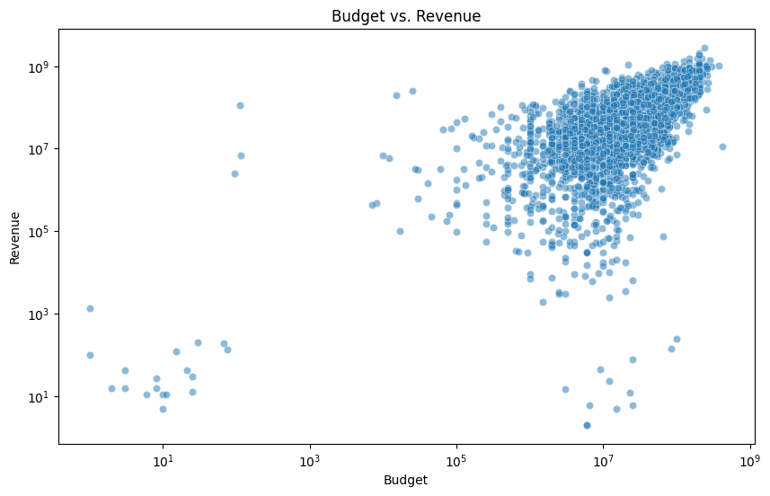
VISUALIZATIONS
Budget vs. Revenue:
how much they cost to make (budget) and how much money they made (revenue).
Most movies: Cost less to make than they make back.
Some movies: Cost a lot to make but don't make much money.
A few movies: Cost a lot to make and make a lot of money.

Slide 9
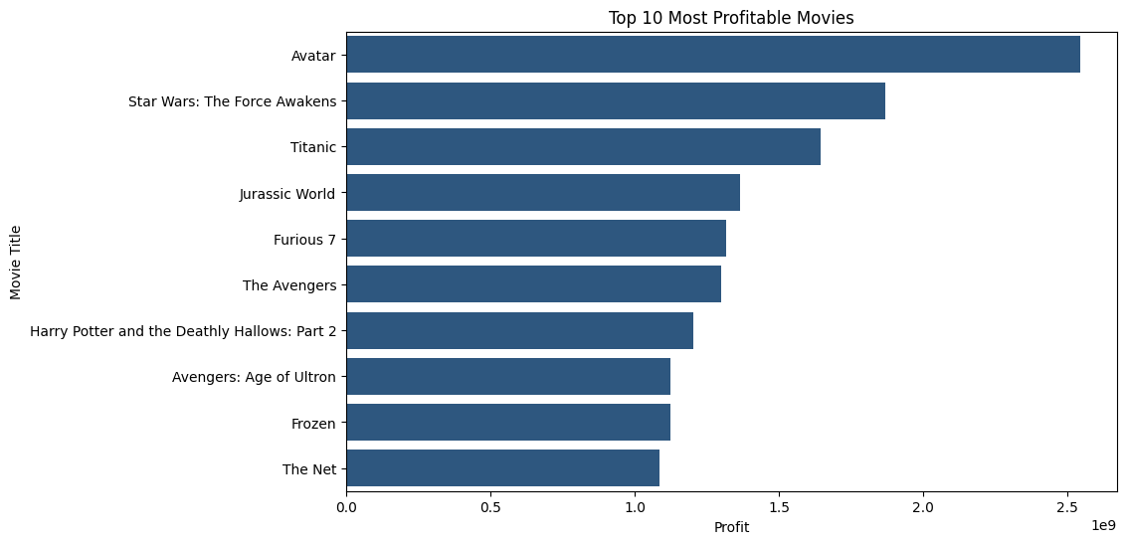
What is the most profitable movie among the top 10 listed?
Avatar: Is the most profitable movie, with the longest bar.
Star Wars: The Force Awakens: Is the second most profitable movie.
Other movies: Also made a lot of profit, but less than the top two.

Slide 10
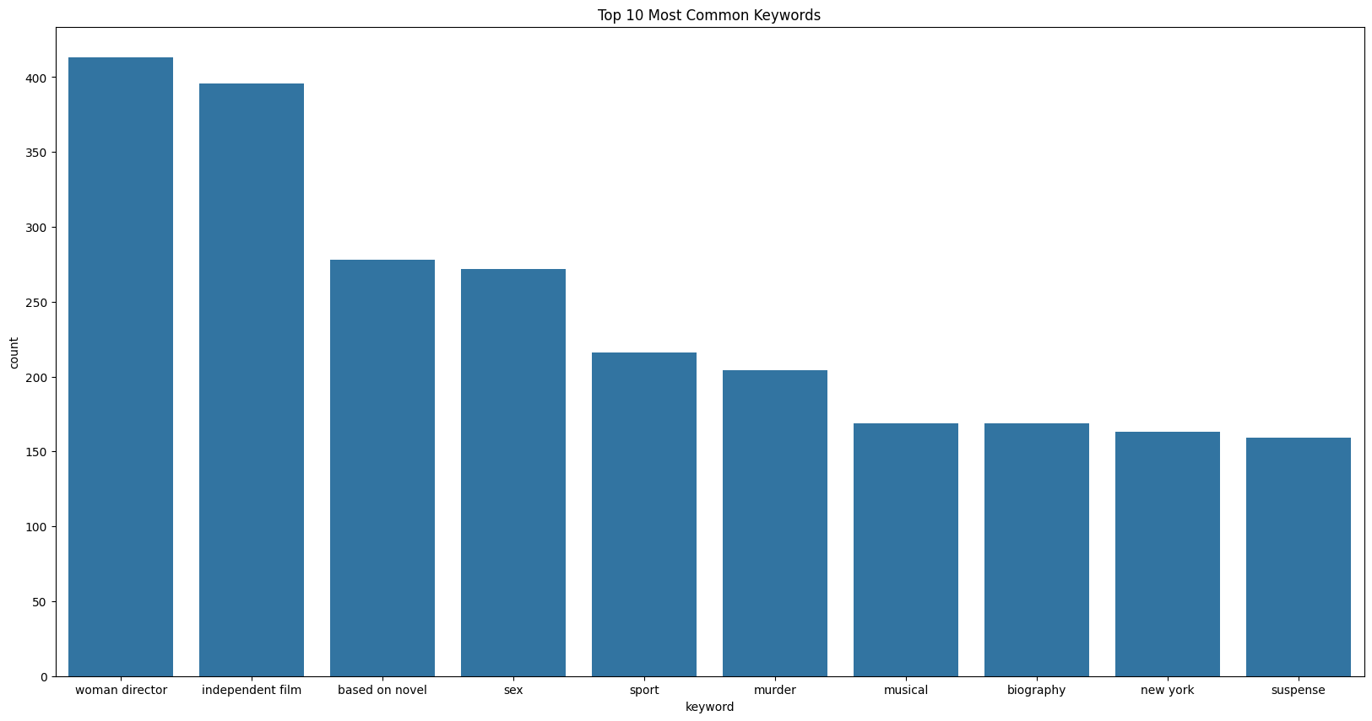
The 10 most common words that appear in movie titles that impact on the popularity
"woman director" is the most common word, appearing in the most movie titles.
"independent film" is the second most common word.
Other common words: Include "based on novel," "sex," "sport," and "murder."

Slide 11
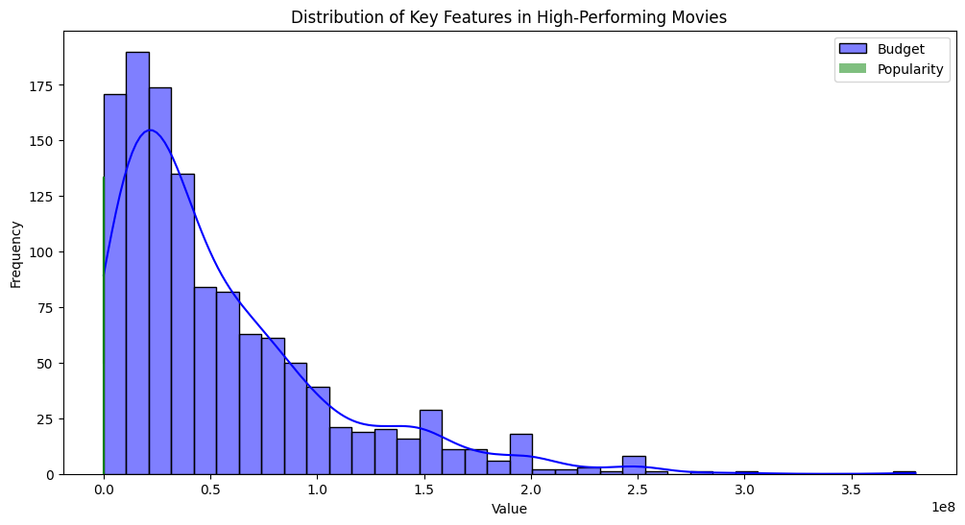
Why are some movies so expensive?
Does a big budget make a movie more popular?
What makes a movie popular besides its cost?
We don't know if expensive movies are always popular or if popular movies always cost a lot.

Slide 12
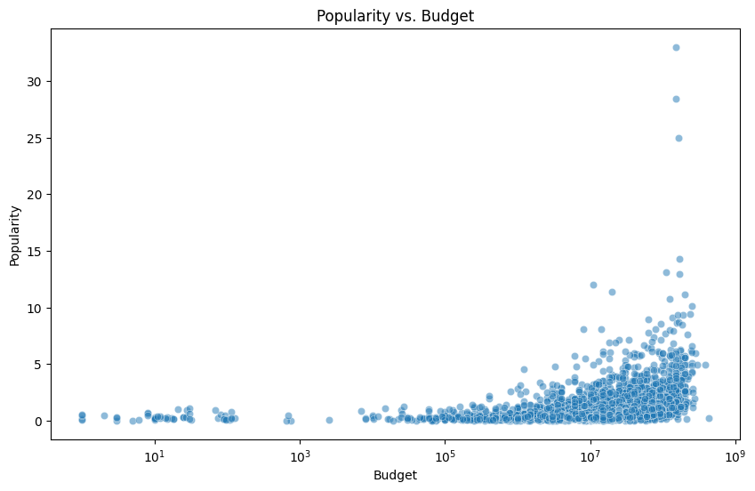
How much they cost to make (budget) and how popular they were?
Most movies: Are not very popular and don't cost a lot to make.
Some movies: Are popular but don't cost a lot to make.
A few movies: Are popular and cost a lot to make.

Slide 13
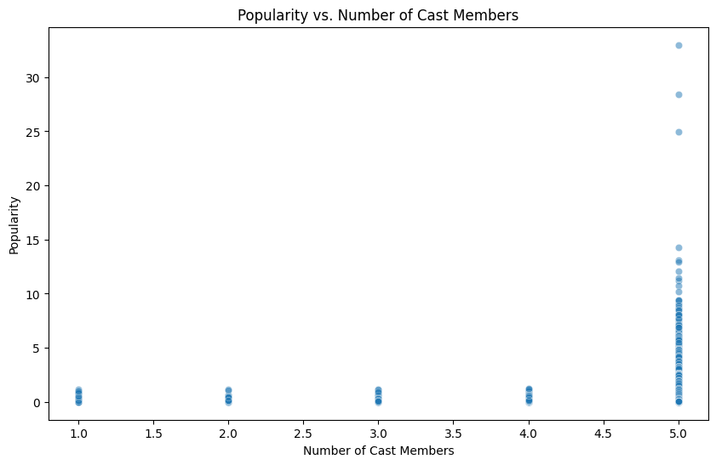
How popular they were and how many people were in the movie (cast members)?
Most movies: Have around 5 cast members and are not very popular.
Some movies: Have a lot of cast members (more than 20) and are popular.
A few movies: Have a small number of cast members (less than 5) and are popular.

Slide 14
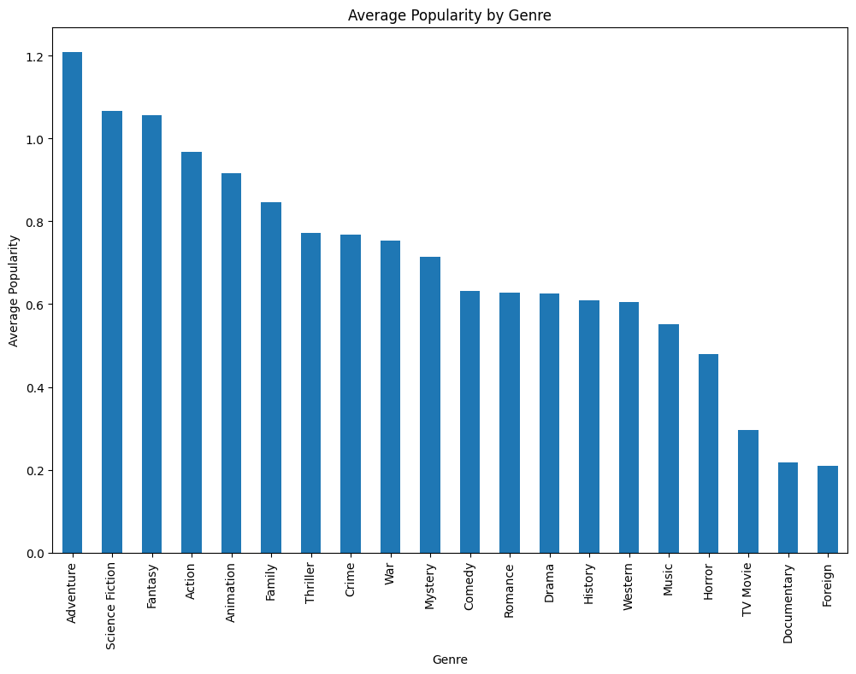
How popular different types (genres) of movies are on average.
Adventure: Is the most popular genre, with the tallest bar.
Documentary: Is the least popular genre, with the shortest bar.
Some genres: Are more popular than others, but there are some that are about the same popularity.

Slide 15
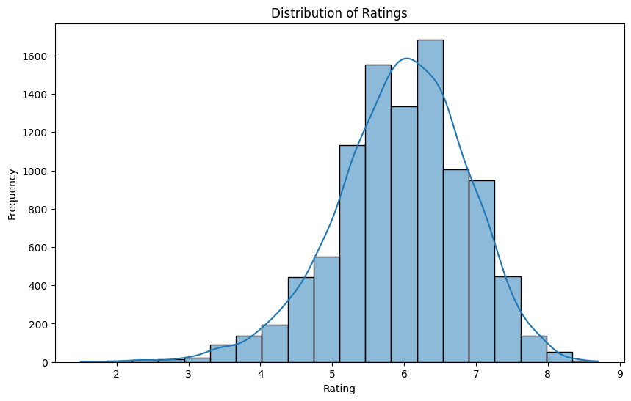
How many movies there are for each rating.
Most movies: Have a rating around 6 or 7.
Fewer movies: Have a rating of 1, 2, 3, 8, 9, or 10.
The curve: Shows us the overall trend of the ratings.

Slide 16
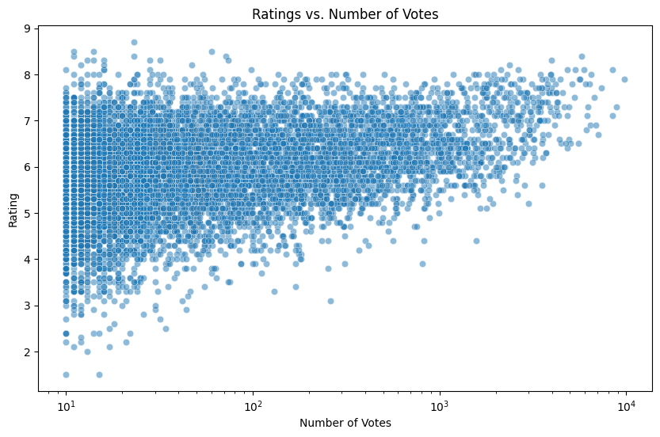
How popular they were (number of votes) and how well they were rated.
Most movies: Have a lot of votes and a rating around 7.
Fewer movies: Have a lot of votes but a low rating.
Some movies: Have a few votes but a high rating.

Slide 17
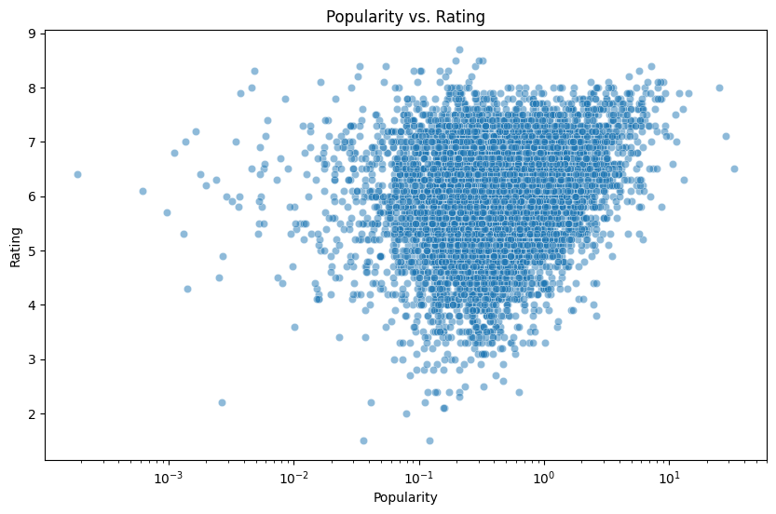
How popular they were and how well they were rated.
Most movies: Are moderately popular and have a rating around 7.
Fewer movies: Are very popular or very unpopular, or have a very low or very high rating.
There's a general trend: Popular movies tend to have higher ratings, but this isn't always the case.

Slide 18
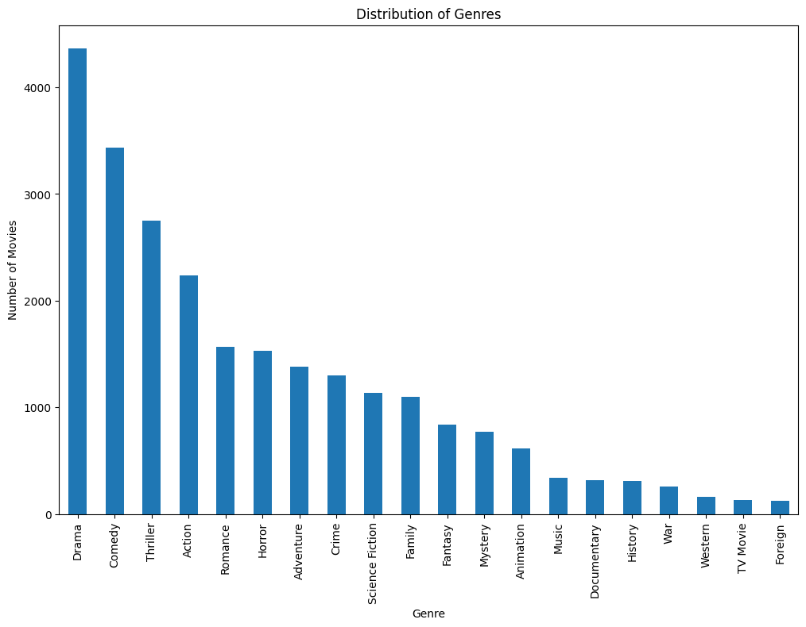
How many movies there are for each type (genre) of movie.
DRAMA: IS THE MOST POPULAR GENRE, WITH THE TALLEST BAR.
COMEDY: IS THE SECOND MOST POPULAR GENRE.
OTHER GENRES: HAVE FEWER MOVIES THAN DRAMA AND COMEDY.

Slide 19
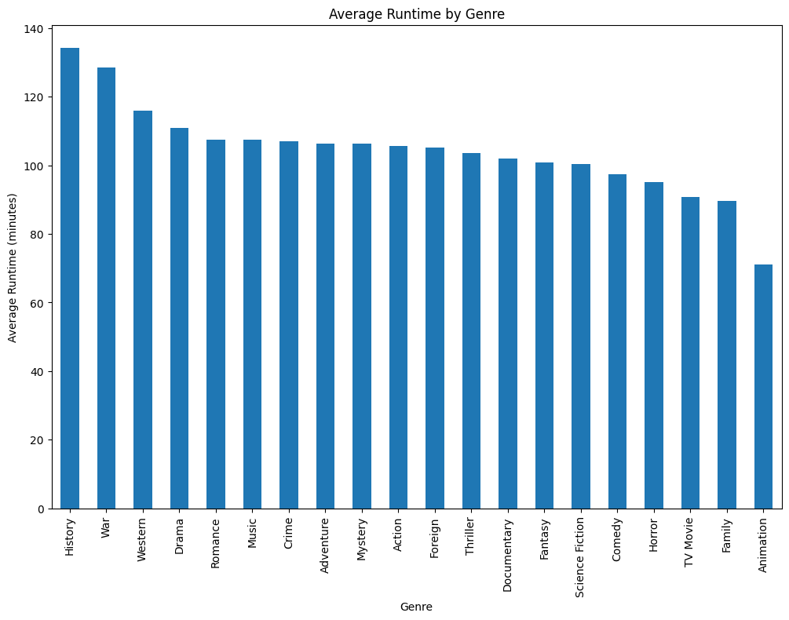
How long different types (genres) of movies are on average.
History: Is the longest genre, with the tallest bar.
Animation: Is the shortest genre, with the shortest bar.
Some genres: Are longer than others, while some are about the same length.

Slide 20
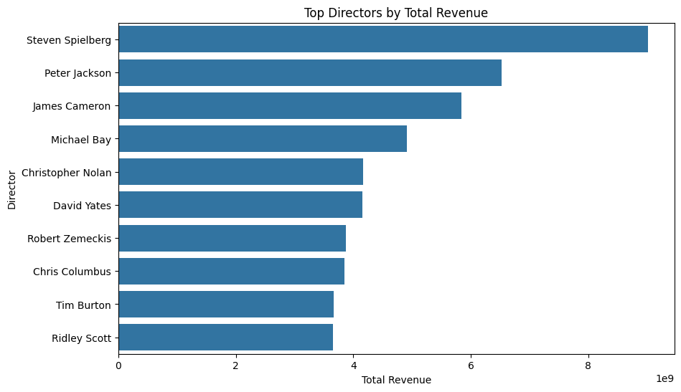
How much money different directors have made from their movies.
Steven Spielberg: Is the director who has made the most money from his movies, with the longest bar.
Ridley Scott: Is the director who has made the least money from his movies, with the shortest bar.
Some directors: Have made similar amounts of money, as shown by the bars being close in length.

Slide 21
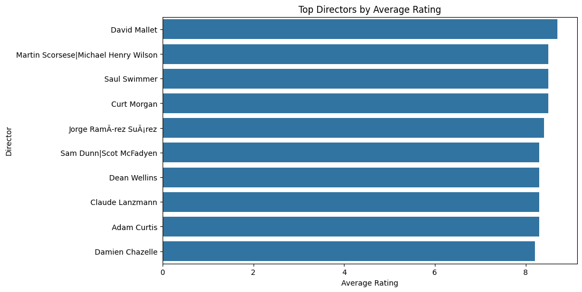
How well a group of directors did in their movies.
David Mallet: Is the highest-rated director, with the longest bar.
Damien Chazelle: Is the lowest-rated director, with the shortest bar.
Some directors: Have similar average ratings, as shown by the bars being close in length.

Slide 22
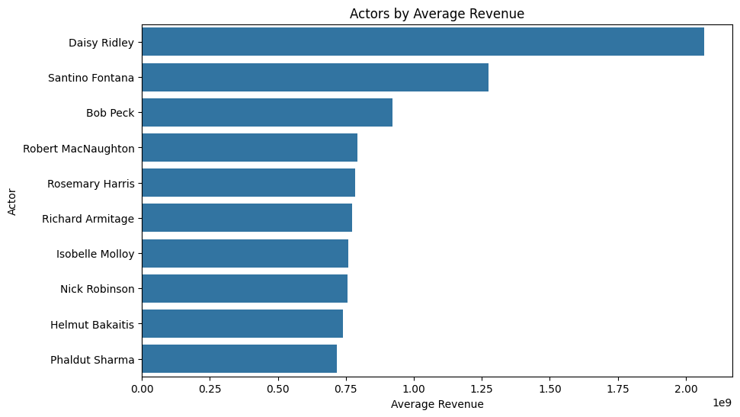
How much money different actors have made on average in their movies.
Daisy Ridley: Is the actor who has made the most money on average, with the longest bar.
Phaldut Sharma: Is the actor who has made the least money on average, with the shortest bar.
Some actors: Have made similar amounts of money, as shown by the bars being close in length.

Slide 23
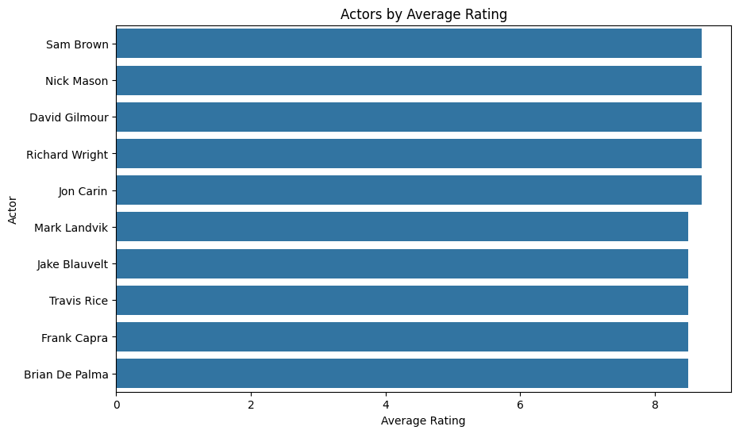
How well a group of actors did in their movies.
Sam Brown: Is the highest-rated actor, with the longest bar.
Brian De Palma: Is the lowest-rated actor, with the shortest bar.
Some actors: Have similar average ratings, as shown by the bars being close in length.

Slide 24
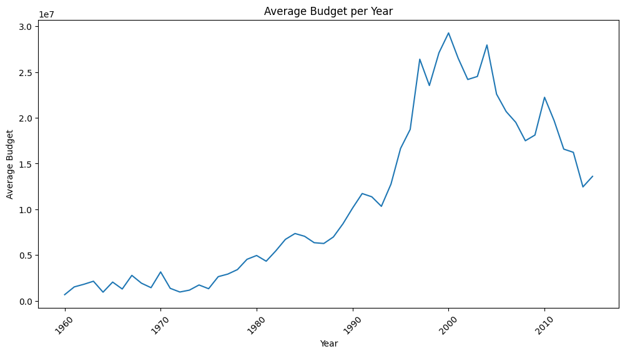
How much money movies made on average each year.
General trend: Movies made more money on average over time.
Some years: The average revenue was higher than others.
Some years: The average revenue was lower than others.

Slide 25
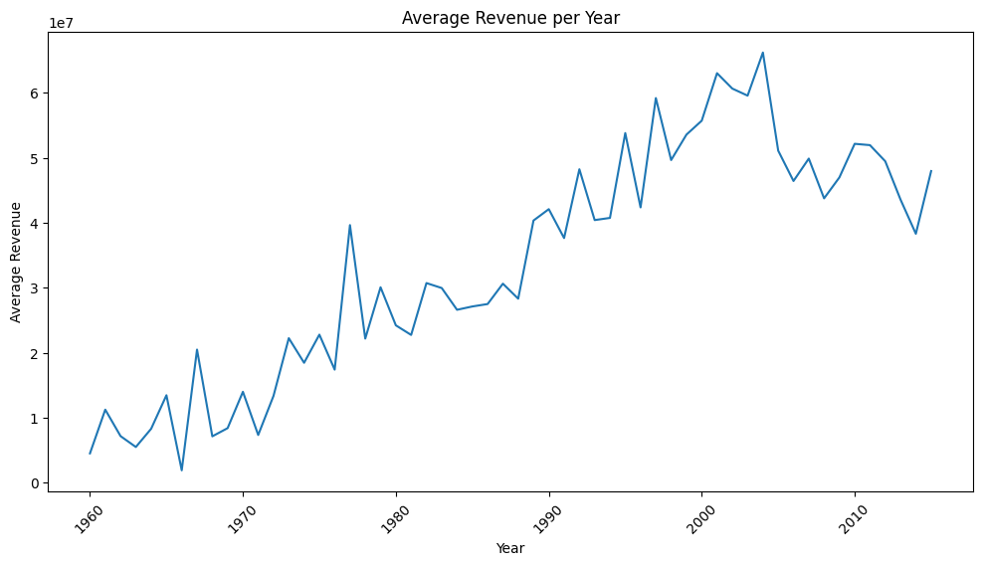
How much money movies made on average each year.
General trend: Movies made more money on average over time.
Some years: The average revenue was higher than others.
Some years: The average revenue was lower than others.

Slide 26
How much movies cost to make on average each year.
General trend: Movies have gotten more expensive to make over time.
Some years: The average budget was higher than others.
Some years: The average budget was lower than others.

Slide 27
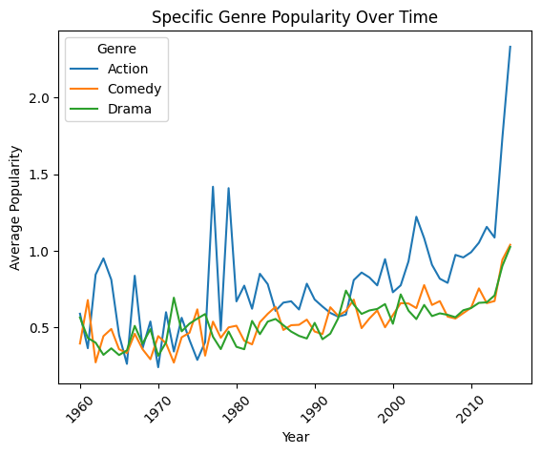
How popular three types of movies (action, comedy, and drama) were over time.
Action movies: Became more popular over time, especially after the 2000s.
Comedy movies: Were popular in the 1970s and 1980s, but became less popular in the 1990s and early 2000s. Their popularity increased again in the 2010s.
Drama movies: Were popular in the 1960s and 1970s, but became less popular in the 1980s and 1990s. Their popularity increased again in the 2000s and 2010s.

Slide 28
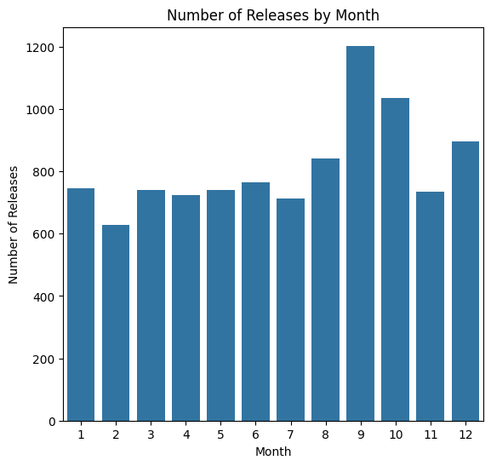
How many movies were released each month.
November (month 11): Is the month with the most movie releases.
December (month 12): Is the second month with the most movie releases.
Some months: Have more releases than others.
Some months: Have fewer releases than others.

Slide 29
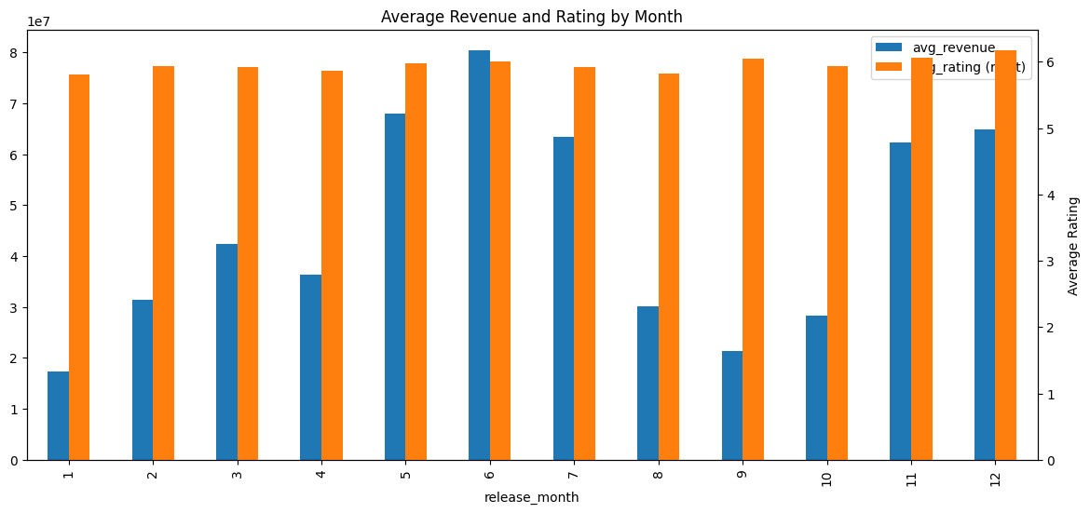
How popular three types of movies (action, comedy, and drama) were over time.
Some months: Had movies that made a lot of money.
Other months: Had movies that were rated very high.
Some months: Had both high revenue and high ratings.
Some months: Had low revenue and low ratings.

Slide 30
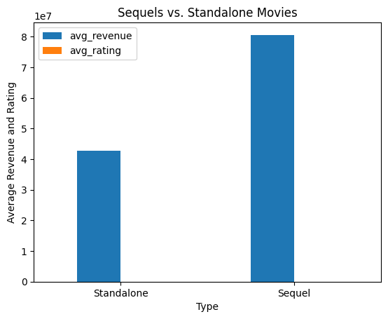
How much money they made on average and how well they were rated.
Sequels: Made more money on average than standalone movies.
Sequels: Had a slightly lower average rating than standalone movies.

Slide 31
Thank you!
Name: Mohamed Said Mahmoud Emam
Email: mohammed.saiid208@gmail.com
Phone: 01146621429
LinkedIn: www.linkedin.com/in/mohamed-said-1193862a7
Colab notebook: https://colab.research.google.com/drive/1YVassbiTyHqSH0NwMKtaeZkpRnYlCjBM?usp=sharing
31 August, 2024

